Slide 1

AI Contract Analyzer – Proof of Concept
Built using Mistral via Ollama
Soumaya, Sagar, Patrick, Harshal, Vijay | April 2025

Slide 2

The Legal Cost Dilemma
$5.5M New Ventures — A record number of U.S. business applications filed in 2022!
55% Entrepreneurs — Over half of adults have launched their own businesses.
$13,304 Legal Costs — The average small business spends over $13K on legal fees.
$10,000 Startup Capital — That’s the average amount needed to kickstart a business.
Should a small business really spend more on legal fees than on building the business itself?

Slide 3
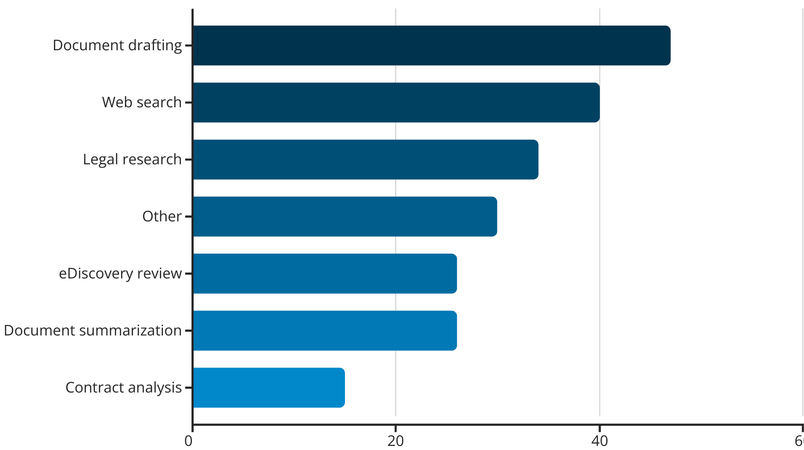

Current Legal Tech Usage
ACEDS survey shows document drafting leads current legal tech applications. Contract analysis remains underutilized at just 15%.
ACEDS survey shows document drafting leads current legal tech applications. Contract analysis remains underutilized at just 15%.

Slide 4




The Problem
Complex Agreements
Hidden Details
Important fees and obligations are often missed in dense text.
Lease agreements are long and complex, making review difficult.
Inefficient Process
Manual review is slow, expensive, and error-prone.

Slide 5

The AI Contract Analyzer
Fast Extraction
Quickly extracts key lease details from complex documents.
Smart Summarization
Summarizes important clauses in clear, concise language.
Risk Detection
Flags obligations and risks that require attention.
Instant Analysis
Analyzes uploaded contracts in seconds, not hours.

Slide 6





How It Works
Upload
User uploads a lease PDF to the system.
Extract
Text is extracted and cleaned for processing.
Process
Mistral model analyzes the text content.
Output
System delivers structured summaries and key terms.

Slide 7







How We Guide the AI
Clear Instructions
Specific prompts tell the model what to extract
Detailed Parameters
We list the exact lease terms for extraction
No Retraining
Uses existing model capabilities without retraining
Our prompt engineering approach guides the AI to output structured information without requiring specialized model training.

Slide 8












Key Terms the AI Flags
Monthly Lease Rate
Length of Lease Term
Property Use
Security Deposit Amount
5
Penalties/Fees
Utilities Responsibility

Slide 9



Example AI Output
Field
Extracted Value
Monthly Lease Rate
$900
Lease Term
1 year
Security Deposit
$700
Utilities
Tenant pays all utilities
Penalties/Fees
$15/day late fee
Property Use
Residential use only

Slide 10






Technology Used
Ollama
Mistral
Python
Runs Mistral locally with minimal setup
Lightweight open-source LLM with strong capabilities
Powers text extraction and application logic
PyMuPDF
Handles PDF reading and text extraction

Slide 11

Next Steps
Visual Highlighting
Highlight important clauses directly within the PDF document.
Contract Comparison
Support side-by-side comparison between multiple contracts.
Expand Contract Types
Add support for service and employment contracts.
Specialized Models
Explore more specialized legal AI models for improved accuracy.

